Slide 1
Getting Started with RAML (Session III)
Using API - Workbench
Alain Lompo
IT Consultant and Developer
RAML MVP

Slide 2
Program
What is RAML?
Why use RAML?
The API Workbench
How to install it
Using API workbench to build raml API
Starting with the Basics
Building your first RAML Api
How to add resources and methods
Adding more details to methods: bodies and responses

Slide 3
Program (II)
Handling sub – resources
Adding examples
Adding types
Handling resource types
Refactoring and extracting resource types
Adding resource type parameters
Handling method parameters
Traits
How to reuse traits, resource type and libraries

Slide 4
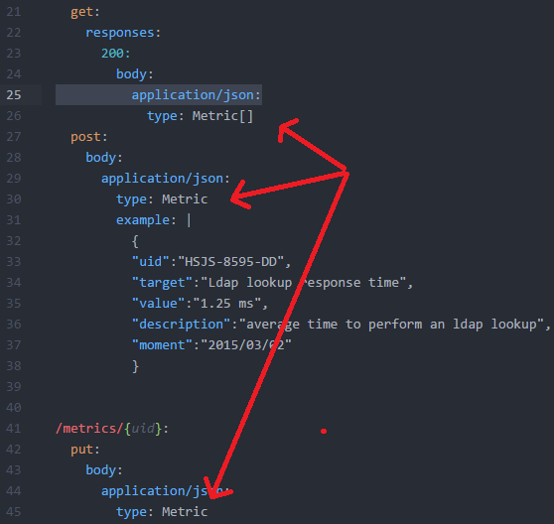
Applying a custom type (we stopped here last time)

Slide 5
Defining resource type
Some resources are defined according to the same pattern
For example all collections generally have at least the following two resources
A first resource that exhibits a get and a post method
A second resource that exhibits methods for handling a single element of the collection (generally put and delete methods)
We thus have a reuse pattern that can help improve our api design.

Slide 6
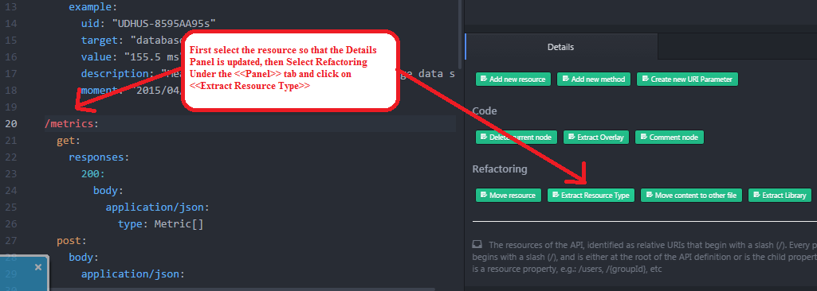
Extracting a resource type

Slide 7
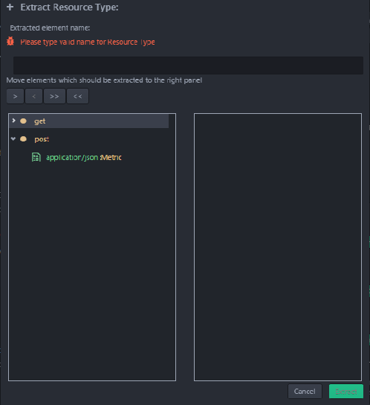
Extracting a resource type….
A dialog opens: it allows you to select the elements that should be part of the resource type as well as to give a valid name to the newly extracted resource type

Slide 8
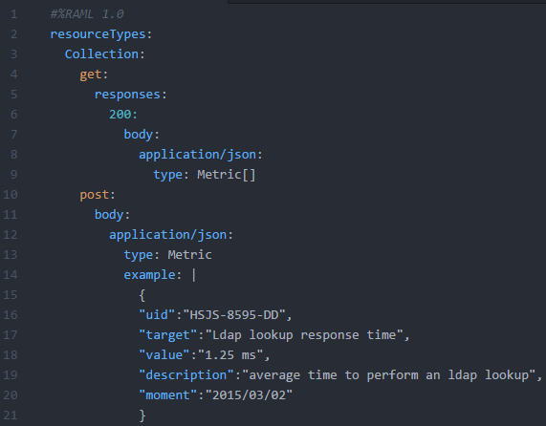
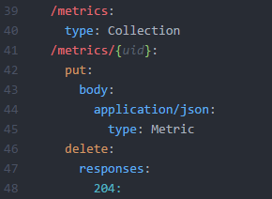
Extracting a resource type ….
After clicking on the extract button the resource type is defined and applied everywhere it fits

Slide 9
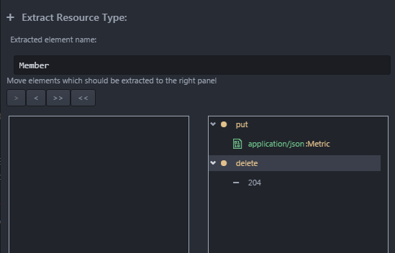
Extracting resource type…
We can do the same for the 2nd resource (element handling resource)
Let’s extract a resource type that allow the reuse of the put and delete methods

Slide 10
Extracting a resource type….
Wait a minute
Maybe I have a collection that has a different element type
I will not handle only Metric collections
Therefore I don’t want the Member resource type to always be of a Metric inner type also.
So how do I specify this?
We shall see next…

Slide 11
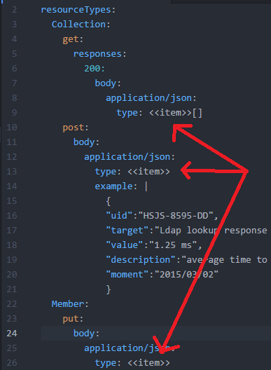
Using generic <<item>> parameter
We will replace the <Metric> element with the <<item>> keyword in both of our resource type definitions
The picture shows the new look of our resource types definitions

Slide 12
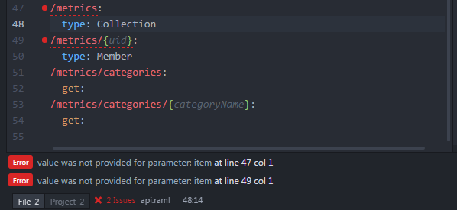
Specifying the right type at the right usage place
Api workbench is now complaining: it wants us to specify the real type for which <<item>> is working as a placeholder

Slide 13

Specifying the type
Specifying the type is similar to the way generics are used in OOP languages such as Java or C#

Slide 14
Method parameters and traits
The actions methods that are used by our resources are now defined in resource types
We made it generic so we can extensively reuse those resource types with different resources that comply to the same pattern
Now we may have case were we have additional parameters that depends directly on the resource
Example the get method may have query parameters that vary in semantic and value from one resource to the other
How do we handle this?

Slide 15
Add query parameter to get method
As an example we will add a get method to our /metrics resource and we will add a query parameter to it
Both get methods will be merged

Slide 16
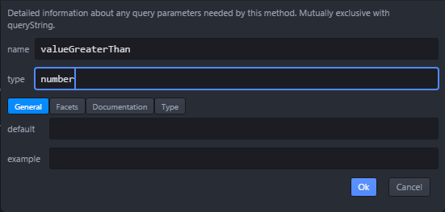
To add a query parameter
First add the get method to the /Metrics resource
Then put the cursor on get: and select <<Create new query parameter>> from Details pane in Palette tab

Slide 17
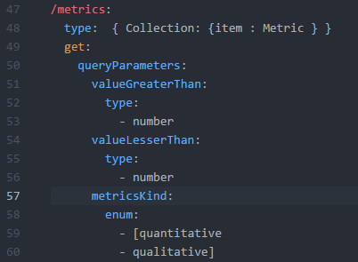
Adding query parameters to a get method:
Here is the new look of our get: method

Slide 18
Filtering a method by a value
The valueGreaterThan and valueLesserThan query parameters function as a filter for our get method
Let’s extract them as so, in order to define a reuse pattern: this is a trait definition by extraction

Slide 19
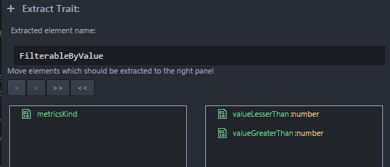
Extracting the filterByValue trait
To extract the filterByValueTrait
Put the cursor on the get method
Click on <<Extract trait>> from Details pane and Palette tab
Pick up the two parameters and leave the metricsKind parameter

Slide 20
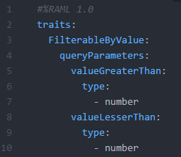
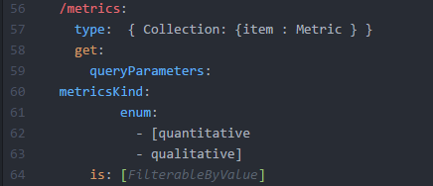
Using the newly defined trait….
The result is shown here:
Usage
Definition

Slide 21
That’s all for now folks
Next time
We will show extensive usage of reusing resource type and traits
We will see how to extract libraries and use !include s
We will also see how to take advantage of code completion features of the API workbench.
We will also do some tough labs ☺

Slide 22

Any question?

